Slide 1
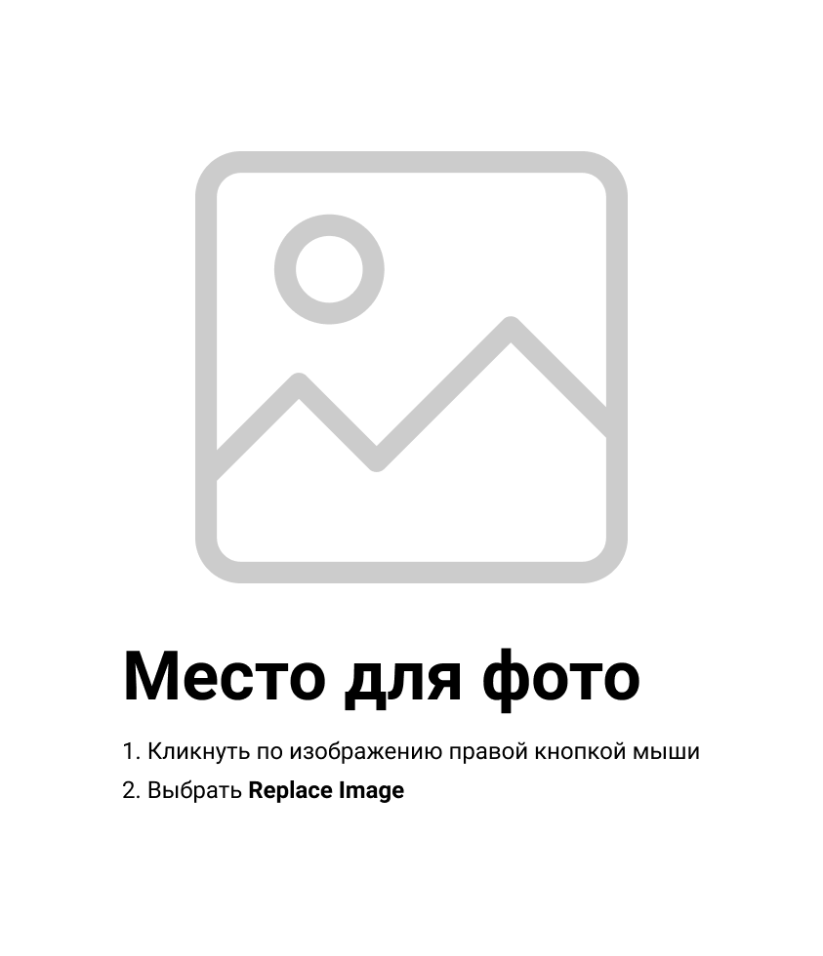
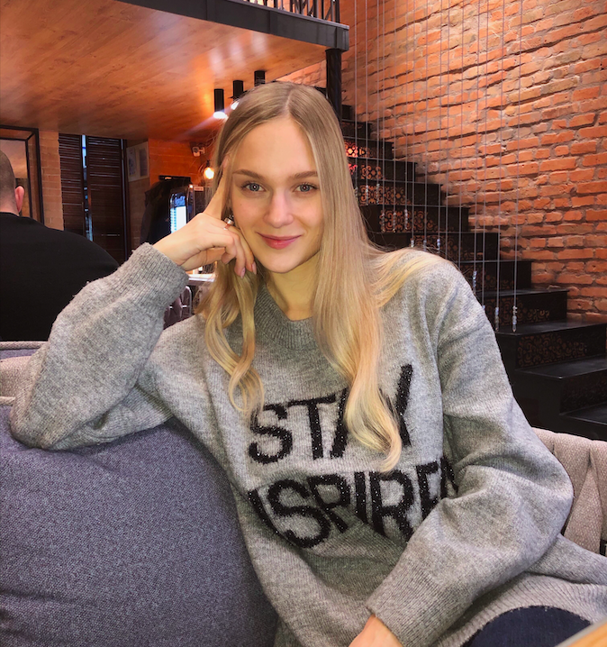
Daria Solodey
Methodist, course creator

Slide 2
🔥
Our goal
Pass a job interview
Our rules:
Turn on your camera
Set up your microphone
Be active
Notes:
Если вам не хватило места, вы можете здесь написать развернутый комментарий.

Slide 3

Lesson Plan:
- Study how to make Small Talk
Notes:
Развернутый комментарий.

Slide 4

What do you see in the picture? Are these people friends? What are they talking about?

Slide 5
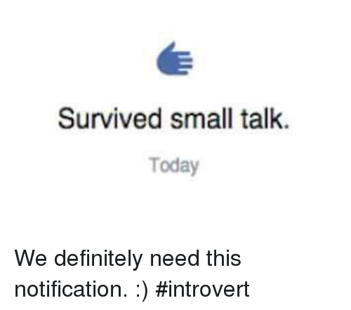
What is small talk?
In what situations do people make small talk?
What is the intention of it?

Slide 6
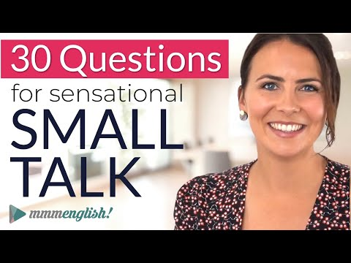
Watch the video and answer the questions
What is the intention of small talk?
What are the most common small talk topics?
Think of any more small talk topics. Share them with groupmates.

Slide 7
Which topics are appropriate for small talk? Why?
Share the ideas and do the task

Slide 8
How to make small talk effectively?
Some people say that they key to small talk is to be interested, not interesting.
Read the list and decide which are the dos and don’ts of small talk.

Slide 9
Put the conversation starters
into the correct categories.
Weather
Work
Travel
Food
Life

Slide 10
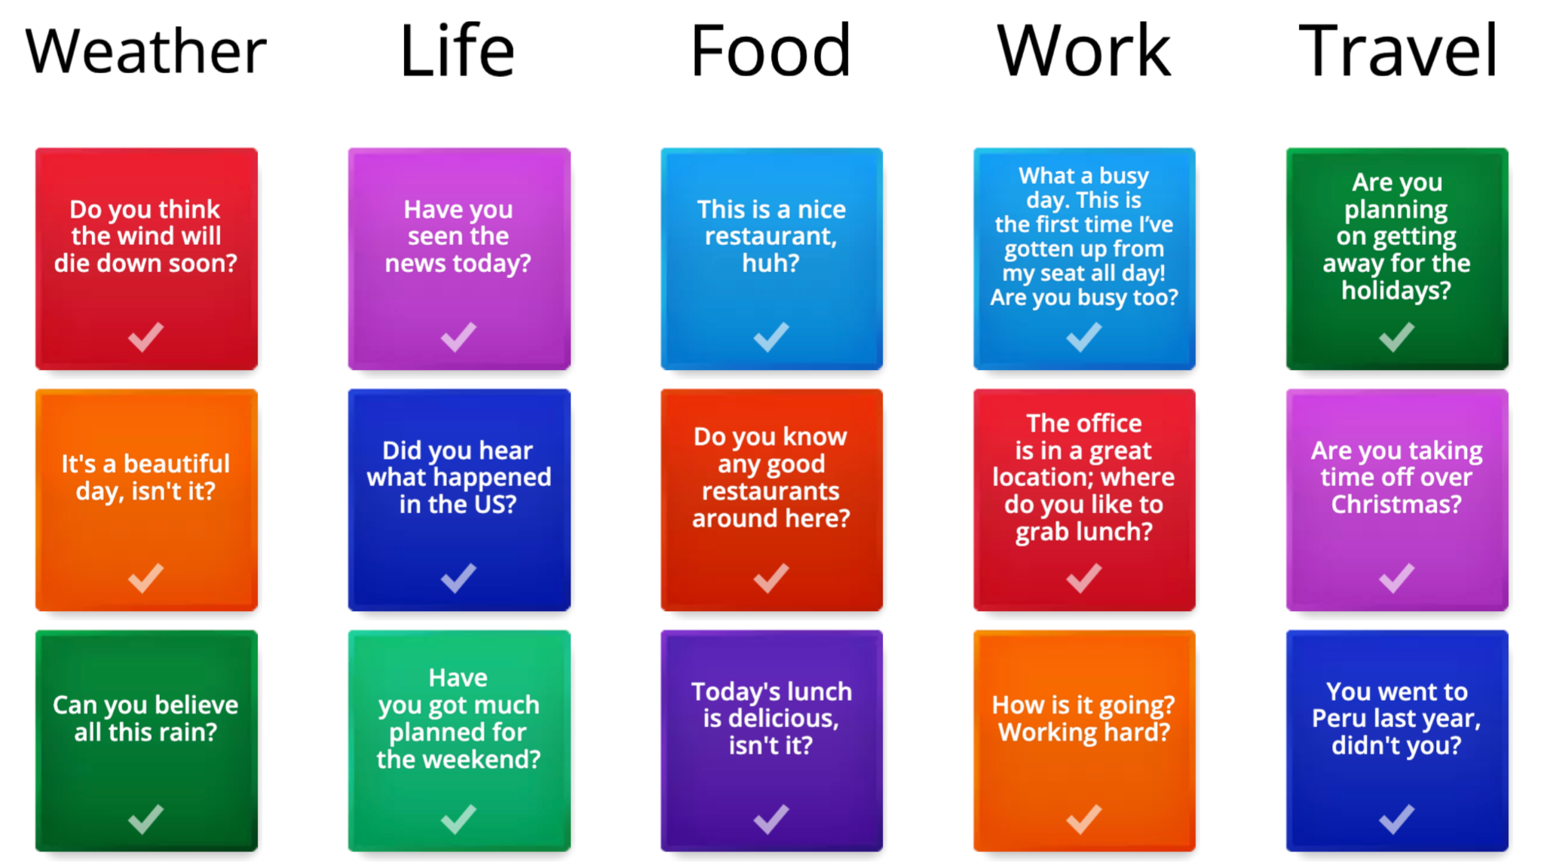
Use these questions or make up your own and make small talk with someone in the group.

Slide 11

What can you do after this lesson?
I learned:
How to make Small Talk
Notes:
Развернутый комментарий

Slide 12
Useful links:
Games:
https://wordwall.net/ru/resource/34801301
https://wordwall.net/ru/resource/35056818
https://wordwall.net/ru/resource/35059934

Slide 13
Thank you!

Slide 14

Do you have any superpowers?
= Do you have any strengths?

